Slide 1
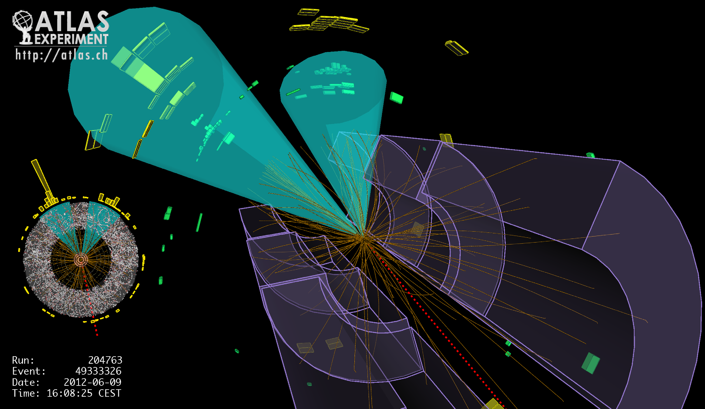
Lecture #5
Prof. Dr. Florencia Canelli
Universität Zürich
Elementary particle physics - PHY451
HS2016
Credits: CERN Summer lectures (di Lella), Thomson, Hadron collider lectures

Slide 2
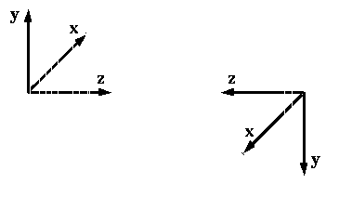
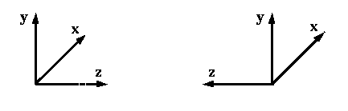
Discrete symmetries
PARITY: the reversal of all three axes in a reference frame
P
( u : unit vectors along the three axes)
P transformation equivalent to a mirror reflection
P
(first, rotate by 180° around the z – axis ; then reverse all three axes)
PARITY INVARIANCE
All physics laws are invariant with respect to a P transformation;
For any given physical system, the mirror-symmetric system is equally probable;
In particle physics Nature does not know the difference between Right and Left.

Slide 3
Parity
P
P
(all three components change sign)
P
(the three components do not change)
Spin s : same behaviour as for angular momentum ( s ⇒ s )
a scalar term of type s · p changes sign under P
If the transition probability for a certain process depends on
a term of type s · p , the process violates parity invariance
Tau-theta puzzle in the early 1950’s :
the decays K⁺ → π⁺ π° and K⁺ → 3 π (π⁺ π⁺ π – and π⁺ π° π° )
A system of two π – mesons and a system of three π – mesons, both in a state of
total angular momentum = 0, have OPPOSITE PARITIES

Slide 4
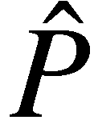
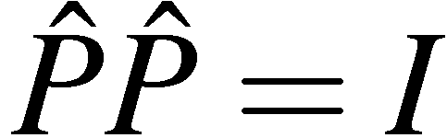
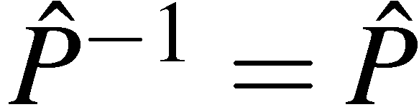
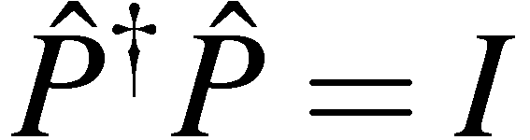
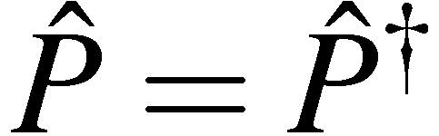
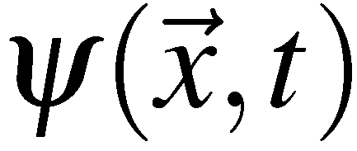

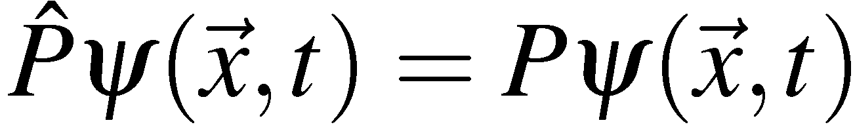
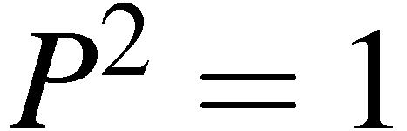
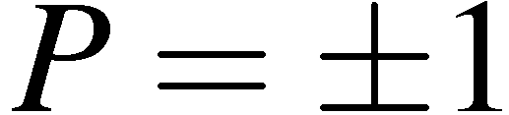
In quantum mechanics
The parity operator performs spatial inversion through the origin:
applying twice:
so
To preserve the normalisation of the wave-function
Unitary
But since
Hermitian
which implies Parity is an observable quantity. If the interaction Hamiltonian
commutes with , parity is an observable conserved quantity
If is an eigenfunction of the parity operator with eigenvalue
since
Parity has eigenvalues

Slide 5
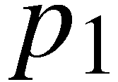
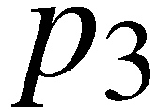

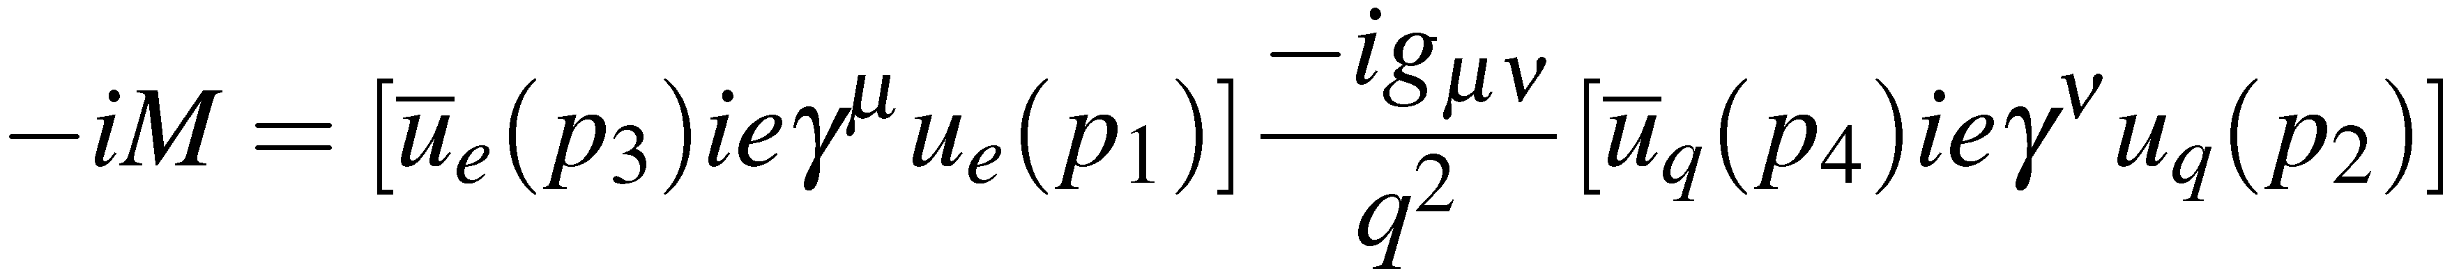
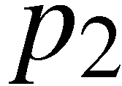
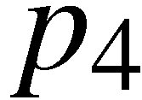
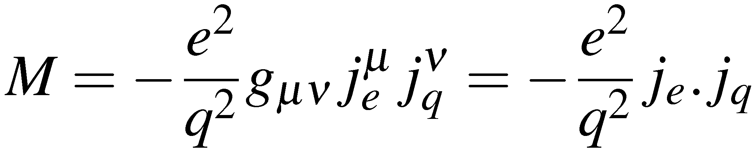

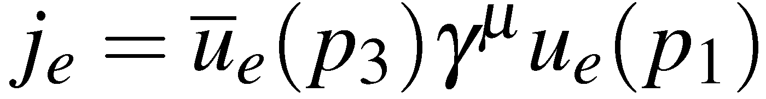
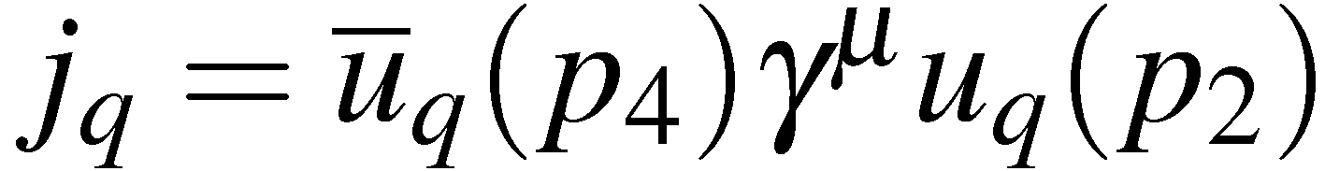
Parity in QED and QCD
Consider the QED process e–q  e–q
e–
e–
The Feynman rules for QED give:
Which can be epressed in terms of the electron and
quark 4-vector currents:
q
q
with
and

Slide 6
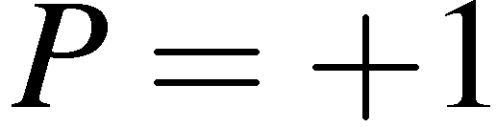
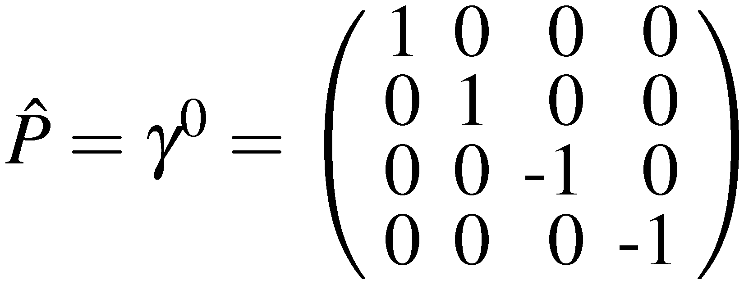
Parity in QED and QCD
Spin-½ Fermions
From the Dirac equation showed
Spin ½ particles have opposite parity to spin ½ anti-particles
Conventional choice: spin ½ particles have
and anti-particles have opposite parity, i.e.
For Dirac spinors it was shown that the parity operator is:

Slide 7
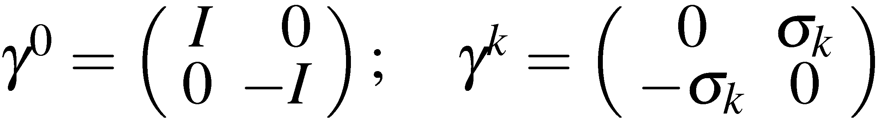
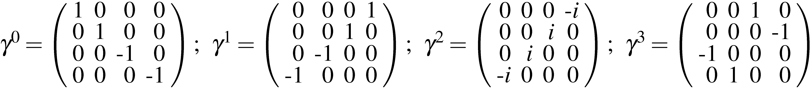
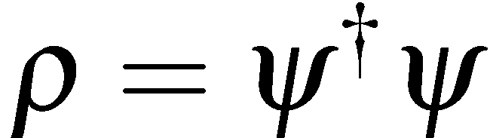
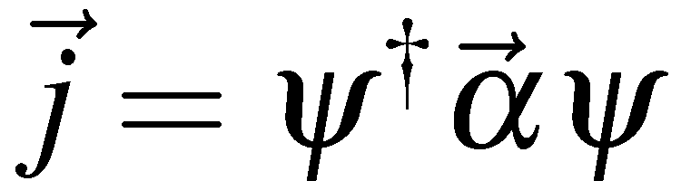
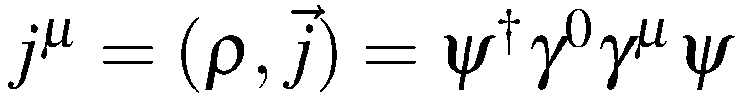
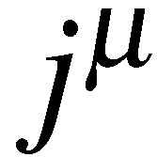
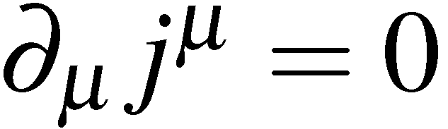
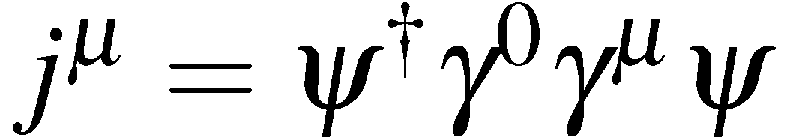
Pauli-Dirac representation (from KTII)
From now on we will use the Pauli-Dirac representation of the gamma matrices:
which when written in full are
Using the gamma matrices
and
can be written as:
where is the four-vector current.
In terms of the four-vector current the continuity equation becomes
Finally the expression for the four-vector current
can be simplified by introducing the adjoint spinor

Slide 8
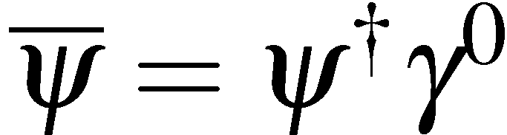
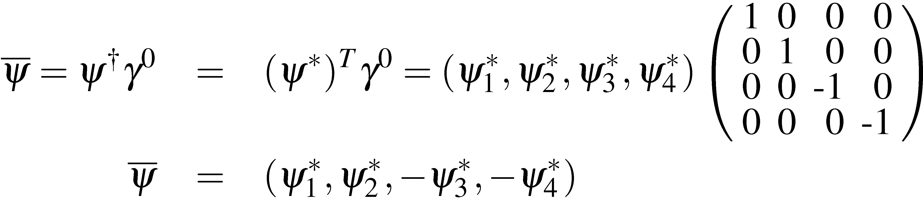
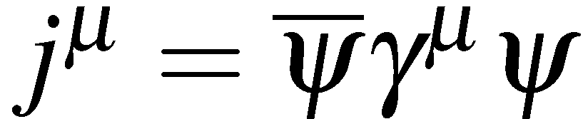
The Adjoint spinor (from KTII)
The adjoint spinor is defined as
i.e.
In terms the adjoint spinor the four vector current can be written:
We will use this expression in deriving the Feynman rules for the
Lorentz invariant matrix element for the fundamental interactions.

Slide 9
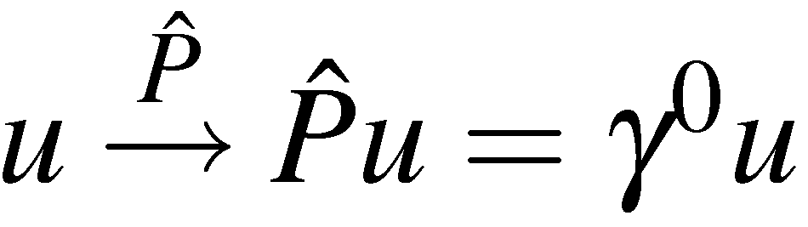
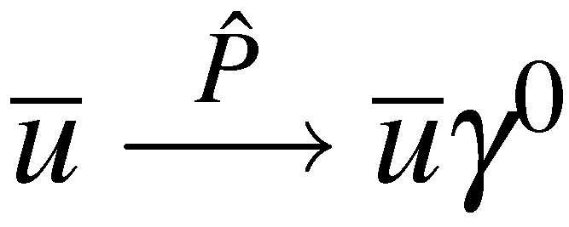
Parity in QED and QCD
Consider the QED process e–q  e–q
e–
e–
The Feynman rules for QED give:
Which can be epressed in terms of the electron and
quark 4-vector currents:
q
q
with
and
Consider the what happen to the matrix element under the parity transformation
Spinors transform as
Adjoint spinors transform as
Hence

Slide 10
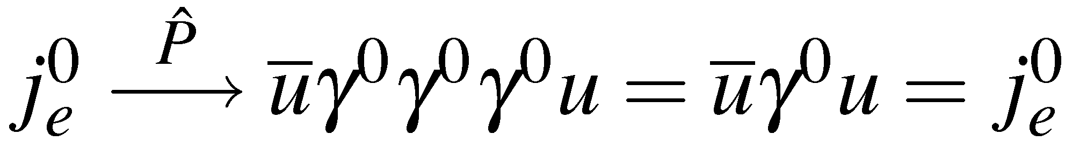
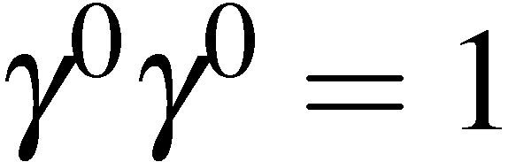
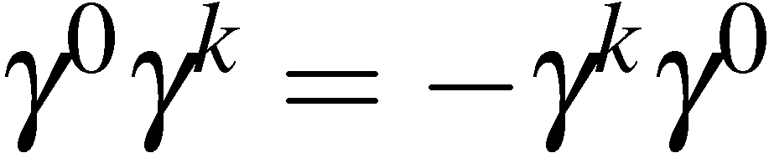
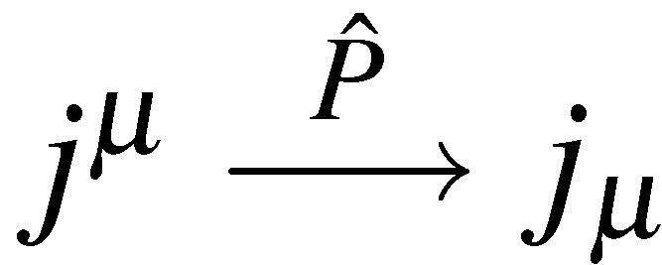
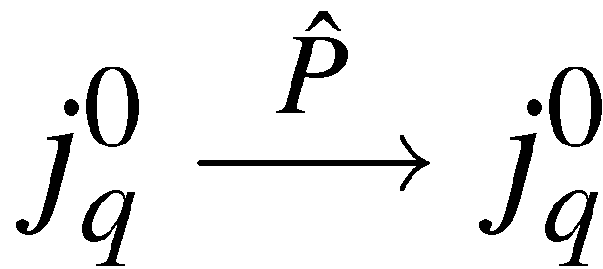
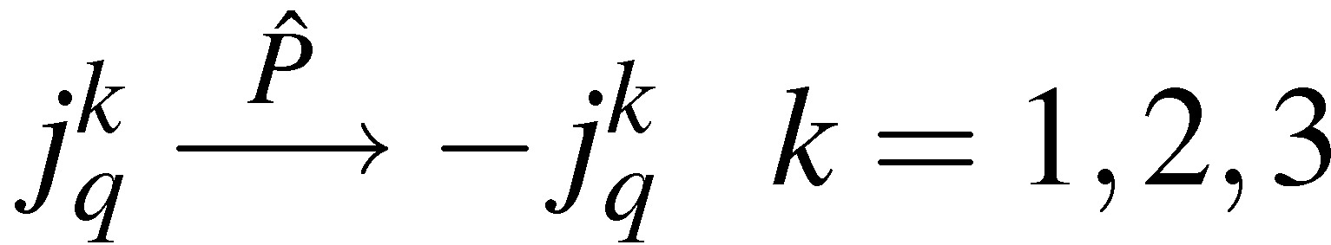
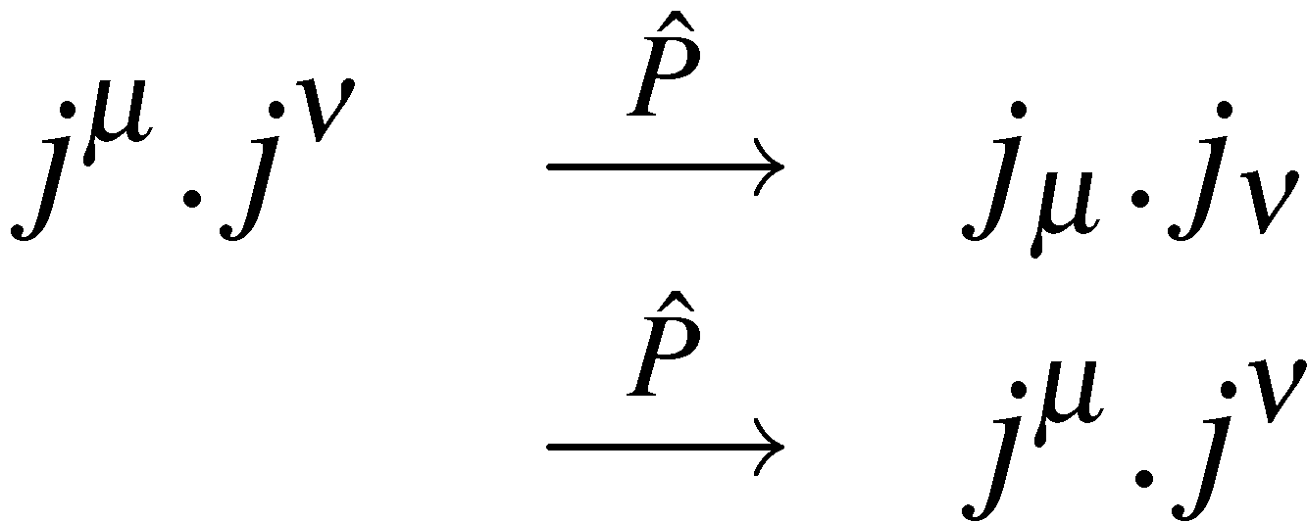
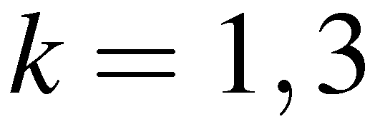
Parity in QED and QCD
Consider the components of the four-vector current
0:
since
k=1,2,3:
since
The time-like component remains unchanged and the space-like components
change sign
or
Similarly
Consequently the four-vector scalar product
QED Matrix Elements are Parity Invariant
Parity Conserved in QED
The QCD vertex has the same form and, thus,
Parity Conserved in QCD

Slide 11
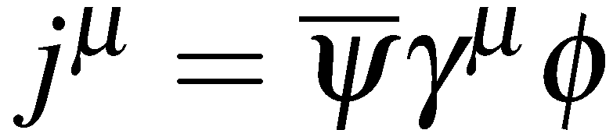
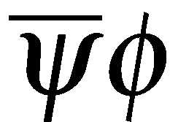
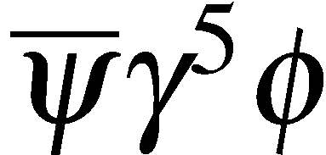
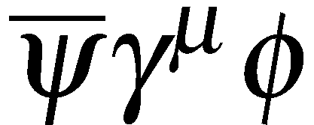
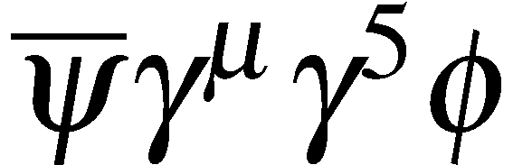
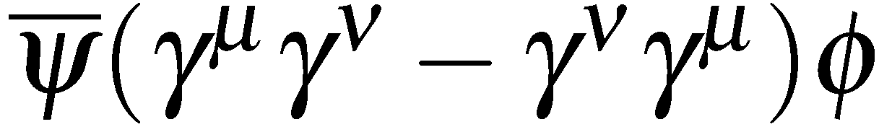
Bilinear covariants
The requirement of Lorentz invariance of the matrix element severely restricts
the form of the interaction vertex. QED and QCD are “VECTOR” interactions:
This combination transforms as a 4-vector
In general, there are only 5 possible combinations of two spinors and the gamma
matrices that form Lorentz invariant currents, called “bilinear covariants”:
Type Form Components “Boson Spin”
SCALAR
PSEUDOSCALAR
VECTOR
AXIAL VECTOR
TENSOR
1
1
4
4
6
0
0
1
1
2
Note that in total the sixteen components correspond to the 16 elements of
a general 4x4 matrix: “decomposition into Lorentz invariant combinations”
Associate SCALAR and PSEUDOSCALAR interactions with the exchange of a
SPIN-0 boson, etc. – no spin degrees of freedom

Slide 12
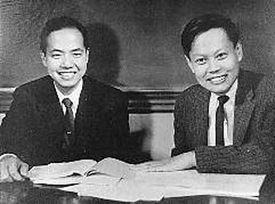
Parity in weak interactions
1956: Suggestion (by T.D. Lee and C.N. Yang)
Weak interactions are NOT INVARIANT under Parity
T.D. Lee and C. N. Yang
π⁺ → μ⁺ + ν decay
Parity invariance requires that the two states
ν
μ⁺
ν
μ⁺
π⁺
π⁺
ν spin
μ spin
ν spin
μ spin
A
B
must be produced with equal probabilities ⇒ the emitted μ⁺ is not polarized
Experiments find that the μ⁺ has full polarization opposite to
the momentum direction
⇒ STATE A DOES NOT EXIST
⇒ MAXIMAL VIOLATION OF PARITY INVARIANCE

Slide 13








Parity in weak interactions
1957: C.S.Wu et al. studied beta decay of polarized cobalt-60 nuclei:
C. S. Wu
Observed electrons emitted preferentially in direction opposite to applied field
If parity were conserved:
expect equal rate for producing e– in directions along and opposite to the nuclear spin.
more e- in c.f.
Conclude parity is violated in WEAK INTERACTION
that the WEAK interaction vertex is NOT of the form

Slide 14
Parity in weak interactions
1957: Garwin, Lederman, Weinrich and Friedman and Telegdi’s experiments found that the μ⁺ has full polarization opposite to the momentum direction
magnetic
field B
μ⁺ stopper
π⁺ beam
μ⁺ emitted along
the π⁺ direction
s_{μ}
μ⁺ magnetic moment (μ_{μ})
parallel to μ⁺ spin s_{μ}
precesses in magnetic field:
precession rate ω = 2 μ_{μ} B / ħ
energy
degrader
Decay electron
detector
Since muons conserve polarization when they come to rest, the electrons from muon decay should also be polarized
Electron angular distribution from μ⁺ decay at rest : dN / d Ω = 1 + α cos θ
: angle between electron direction and μ⁺ spin s_{μ}
cos θ ∝ s_{μ} · p_{e} (term violating P invariance)
Spin precession: cos θ ⇒ cos (ω t + φ)
⇒ modulation of the decay electron time distribution

Slide 15


Parity in weak interactions
Positrons from muon decay were detected by telescope 3-4
Coincidence between counters 1-2 (muons) plus coincidence between counters 3-4 (positrons)
Changing the field, changes the rate of the spin precession, resulting in a angular distribution of the emitted positrons
20 cm
Separate from pions
Muons stop here
Experimental results:
α = − 1/3 ⇒ evidence for P violation in μ⁺ decay
Simultaneous measurement of the μ⁺ magnetic moment:

Slide 16
Helicity of neutrinos
1957: experiment to determine the helicity of the neutrino (M. Goldhaber et al.)
Use electron capture of the nucleus ¹⁵² Eu:
J = 0 1 0
¹⁵²Eu e
¹⁵²Eu e
ν ¹⁵²Sm*
ν ¹⁵²Sm*
J_{z} = +1/2
J_{z} = -1/2
¹⁵²Sm*
γ
¹⁵²Sm*
γ
J_{z} = +1
J_{z} = -1
Measuring circular polarization of the gamma ray, the neutrino helicity is measured
Neutrino is left-handed

Slide 17


V-A structure of the weak interactions
The most general form for the interaction between a fermion and a boson is a
linear combination of bilinear covariants
For an interaction corresponding to the exchange of a spin-1 particle the most
general form is a linear combination of VECTOR and AXIAL-VECTOR
The form for WEAK interaction is determined from experiment to be
VECTOR – AXIAL-VECTOR (V – A)
e–
ν_{e}
V – A
BUT -- is it really that way – absolutely?

Slide 18














Evidence for V-A
The V-A nature of the charged current weak interaction vertex fits with experiment
EXAMPLE charged pion decay
Experimentally measure:
Theoretical predictions (depend on Lorentz Structure of the interaction)
V-A
or
V+A
Scalar
or
Pseudo-Scalar
EXAMPLE muon decay
Measure electron energy and angular distributions relative to muon spin direction. Results expressed in terms
of general S+P+V+A+T form in“Michel Parameters”
e.g. TWIST expt: 6x10⁹ μ decays Phys. Rev. Lett. 95 (2005) 101805
V-A Prediction:

Slide 19



V-A structure of the weak interactions
Can this account for parity violation?
First consider parity transformation of a pure AXIAL-VECTOR current
with
or
The space-like components remain unchanged and the time-like components
change sign (the opposite to the parity properties of a vector-current)

Slide 20



V-A structure of the weak interactions
Now consider the matrix elements
For the combination of a two axial-vector currents
Consequently parity is conserved for both a pure vector and pure axial-vector
interactions
However the combination of a vector current and an axial vector current
changes sign under parity – can give parity violation !

Slide 21






V-A structure of the weak interactions
Now consider a general linear combination of VECTOR and AXIAL-VECTOR
(note this is relevant for the Z-boson vertex)
Consider the parity transformation of this scalar product
If either g_{A} or g_{V} is zero, Parity is conserved, i.e. parity conserved in a
pure VECTOR or pure AXIAL-VECTOR interaction
Relative strength of parity violating part
Maximal Parity Violation for V-A (or V+A)

Slide 22






Chirality
The helicity eigenstates for a particle/anti-particle for are:
where
Define the matrix
In the limit the helicity states are also eigenstates of
In general, define the eigenstates of as LEFT and RIGHT HANDED CHIRAL
states
i.e.
In the LIMIT (and ONLY IN THIS LIMIT):

Slide 23



Chirality
This is a subtle but important point: in general the HELICITY and CHIRAL
eigenstates are not the same. It is only in the ultra-relativistic limit that the
chiral eigenstates correspond to the helicity eigenstates.
Chirality is an import concept in the structure of QED, and any interaction of the
form
In general, the eigenstates of the chirality operator are:
Define the projection operators:
The projection operators, project out the chiral eigenstates
Note projects out right-handed particle states and left-handed anti-particle states
We can then write any spinor in terms of it left and right-handed
chiral components:

Slide 24


Chirality in QED
In QED the basic interaction between a fermion and photon is:
Can decompose the spinors in terms of Left and Right-handed chiral components:
Using the properties of
it is straightforward to show
Hence only certain combinations of chiral eigenstates contribute to the
interaction. This statement is ALWAYS true.
For , the chiral and helicity eigenstates are equivalent. This implies that
for only certain helicity combinations contribute to the QED vertex !
This is why previously we found that for two of the four helicity combinations
for the muon current were zero

Slide 25
Chirality in QED
In the ultra-relativistic limit the helicity eigenstates ≡ chiral eigenstates
In this limit, the only non-zero helicity combinations in QED are:
Scattering:
“Helicity conservation”
R
R
L
L
Annihilation:
L
R
R
L

Slide 26









Chirality in weak interactions
The charged current (W±) weak vertex is:
e–
ν_{e}
Since projects out left-handed chiral particle states:
Writing and from discussion of QED, gives
Only the left-handed chiral components of particle spinors and right-handed chiral components of anti-particle spinors participate in charged current weak interactions
At very high energy , the left-handed chiral components are
helicity eigenstates :
LEFT-HANDED PARTICLES
Helicity = -1
RIGHT-HANDED ANTI-PARTICLES
Helicity = +1

Slide 27





Chirality in weak interactions
In the ultra-relativistic limit only left-handed particles and right-handed antiparticles participate in charged current weak interactions
e.g. In the relativistic limit, the only possible electron – neutrino interactions are:
e–
ν_{e}
ν_{e}
e⁺
ν_{e}
e–
The helicity dependence of the weak interaction parity violation
e.g.
RH anti-particle
LH particle
RH particle
LH anti-particle
Valid weak interaction
Does not occur

Slide 28







Connection to Fermi theory
In 1934, before the discovery of parity violation, Fermi proposed, in analogy
with QED, that the invariant matrix element for β-decay was of the form:
where
Note the absence of a propagator : i.e. this represents an interaction at a point
After the discovery of parity violation in 1957 this was modified to
(the factor of √2 was included so the numerical value of G_{F} did not need to be changed)
Compare to the prediction for W-boson exchange
which for becomes:
Still usually use to express strength
of weak interaction as the is the quantity
that is precisely determined in muon decay

Slide 29
Neutrino detection
Prediction of Fermi’s theory: ν + p → e⁺ + n
ν – p interaction probability in thickness dx of hydrogen-rich material (e.g., H₂O)
Incident ν:
Flux Φ [ ν cm^{–2} s^{–1} ]
(uniform over surface S)
Target:
surface S, thickness dx
containing n protons cm^{–3}
dx
ν p interaction rate = Φ S n σ dx interactions per second
σ : ν – proton cross-section (effective proton area, as seen by the incident ν )
ν p interaction probability = n σ dx = dx / λ
Interaction mean free path: λ = 1 / n σ
Interaction probability for finite target thickness T = 1 – exp(–T / λ)
σ( ν p) ≈ 10^{–4 3} cm² for 3 MeV ν ⇒ λ ≈ 150 light-years of water !
Interaction probability ≈ T / λ very small (~10^{–18} per meter H₂O)
⇒ need very intense sources for antineutrino detection

Slide 30
Nuclear reactors
Very intense antineutrino sources
Average fission: n + ²³⁵U₉₂ → (A₁, Z) + (A₂, 92 – Z) + 2.5 free neutrons + 200 MeV
nuclei with
large neutron excess
a chain of β decays with very short lifetimes:
(A, Z) (A, Z + 1) (A, Z + 2) ....
(until a stable or long lifetime
nucleus is reached)
e– ν
e– ν
e– ν
On average, 6 ν per fission
conversion factor
MeV → J
P_{t}: reactor thermal power [W]
For a typical reactor: P_{t} = 3 x 10⁹ W ⇒ 5.6 x 10²⁰ ν / s (isotropic)
Continuous ν energy spectrum – average energy ~3 MeV

Slide 31



First neutrino detection
1953: Idea from F. Reines and C. Cowan to use the pulse of huge neutrino flux coming out of a nuclear reactors
ν + p → e⁺ + n
F. Reines and C. Cowan
detect 0.5 MeV γ-rays from e⁺e– → γ γ
(t = 0)
neutron “thermalization” followed
by capture in Cd nuclei ⇒ emission
of delayed γ-rays (average delay ~30 μs)
E_{γ} = 0.5 MeV
2 m
H₂O +
CdCl₂
Event rate at the Savannah River
nuclear power plant:
3.0 ± 0.2 events / hour
(after subtracting event rate measured
with reactor OFF )
in agreement with expectations
I, II, III:
Liquid scintillator

Slide 32
Another neutrino
A puzzle of the late 1950’s: the absence of μ → e γ decays
Experimental limit: < 1 in 10⁶ μ⁺ → e⁺ ν ν decays
A possible solution: existence of a new, conserved “muonic” quantum number
distinguishing muons from electrons
To allow μ⁺ → e⁺ ν ν decays, ν must have “muonic” quantum number
but not ν ⇒ in μ⁺ decay the ν is not the antiparticle of ν
⇒ two distinct neutrinos (ν_{e} , ν_{μ}) in the decay μ⁺ → e⁺ ν_{e} ν_{μ}
Consequence for π – meson decays: π⁺ → μ⁺ ν_{μ} ; π⁻ → μ– ν_{μ} to conserve the “muonic” quantum number
High energy proton accelerators: intense sources of π± – mesons ⇒ ν_{μ} , ν_{μ}
Experimental method
ν_{μ} , ν_{μ}
π decay region
proton
beam
Shielding
to stop all other particles,
including μ from π decay
Neutrino
detector
target
If ν_{μ} ≠ ν_{e} , ν_{μ} interactions produce μ– and not e– (example: ν_{μ} + n → μ– + p)

Slide 33



Another neutrino
1962: ν_{μ} discovery at the Brookhaven AGS (a 30 GeV proton synchrotron running at 17 GeV for the neutrino experiment)
13. 5 m iron shielding
(enough to stop 17 GeV muons)
Neutrino energy spectrum
known from π , Κ production
and π → μ , K → μ decay kinematics
Spark chamber
each with 9 Al plates
(112 x 112 x 2.5 cm)
mass 1 Ton
Muon – electron separation
Muon: long track
Electron: short, multi-spark event
from electromagnetic shower
Neutrino detector

Slide 34


Discovery of the muon neutrino
64 “events” from a 300 hour run:
M. Schwartz, J Steinberger, L. Lederman
34 single track events, consistent with μ track
2 events consistent with electron shower (from small, calculable ν_{e} contamination in beam)
Clear demonstration that
ν_{μ} ≠ ν_{e}
Three typical single-track events
in the BNL neutrino experiment

Slide 35
Around 1960’s
Leptons: e, ν_{e}, μ, ν_{μ}
Quarks: d,u,s

Slide 36
Tuesday lectures
Date | Topic | Student
Sept 27 | Positron (p9) Muon (p29) Pion (p34) | Nici Alex Kevin
Oct 4 | Unstable particles (p65 or p71) Anti-p (p87) or Anti-n (p94) | Lukas Oliver
Oct 11 | Omega-(p144) Parity violation in beta (p163) Parity violation in pions (165) | Magnus Nici Alex
Oct 18 | K-long (p197) CP violation (p206) | Kevin Lukas
Oct 25 | J and Psi Tau lepton Charm meson
Nov 2 | Quarks SLAC Gluons TASSO Jets UA2
Date | Topic | Student
Nov 8 | Upsilons CLEO b
Nov 15 | Neutral currents Discovery of the W boson Neutrino species
Nov 22 | Discovery of the top quark Top quark mass measurement
Nov 29 | ARGUS CDF (or Belle/Babar)
Dec 6 | Solar Atmospheric
Dec 20 | Higgs discovery by ATLAS or CMS Measurements of Higgs boson properties
From pages from R. Cahn and G. Goldhaber book if available

